Slide 1
Three-Year Outcomes after Transcatheter or Surgical Aortic Valve Replacement in High-Risk Patients with Severe Aortic Stenosis
Vinod H. Thourani, MD
on behalf of The PARTNER Trial Investigators
ACC 2013 | San Francisco | March 11, 2013

Slide 2
Disclosure Statement of Financial Interest
Within the past 12 months, I or my spouse/partner have had a financial interest/arrangement or affiliation with the organization(s) listed below.
Affiliation/Financial Relationship
Company
Grant/Research Support
Consulting Fees/Honoraria
Major Stock Shareholder/Equity
Ownership/Founder
Intellectual Property Rights
Edwards Lifesciences, Sorin Medical
Sorin Medical, St. Jude Medical
Apica Cardiovascular
Apica Cardiovascular
Apica Cardiovascular

Slide 3
Background
The randomized PARTNER trial demonstrated that transcatheter aortic valve replacement (TAVR) resulted in similar mortality compared with surgical AVR at one year in patients who were high-risk surgical candidates.
Longer term outcomes following TAVR are unknown and are necessary to assess valve performance and to analyze late complications before TAVR can be applied more widely.

Slide 4
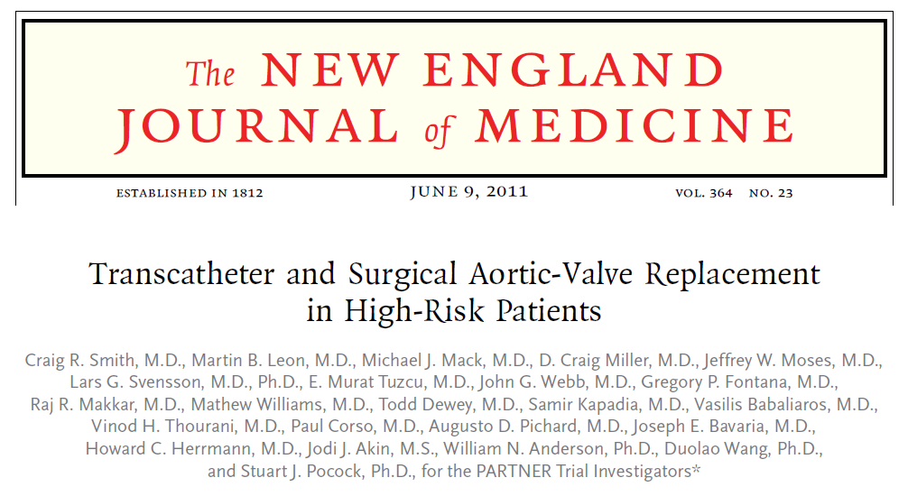
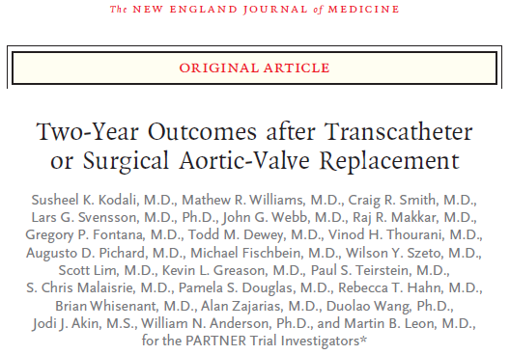
Publications in NEJM
1-Year outcomes published on-line June 5, 2011
@ NEJM.org and in print June 9, 2011
2-Year outcomes published on-line March 26, 2012
@ NEJM.org and print May 3, 2012

Slide 5
Purpose
In patients with severe AS at high-risk for surgery, randomized to either TAVR or surgical AVR, after ≥ 3 years follow-up, to assess:
  mortality, stroke and other clinical outcomes
  clinical and procedural predictors of mortality
  valve performance by echocardiography

Slide 6
PARTNER Study Design
Symptomatic Severe Aortic Stenosis
ASSESSMENT: High-Risk AVR Candidate
3,105 Total Patients Screened
Total = 1,057 patients
N = 699
High Risk
Inoperable
N = 358
2 Parallel Trials:
Individually Powered
Yes
ASSESSMENT: Transfemoral Access
No
ASSESSMENT: Transfemoral Access
Transfemoral (TF)
Transapical (TA)
Yes
No
1:1 Randomization
1:1 Randomization
1:1 Randomization
Not In Study
N = 244
N = 248
N = 104
N = 103
N = 179
N = 179
TF TAVR
AVR
TA TAVR
AVR
TF TAVR
Standard
Therapy
VS
VS
VS
Primary Endpoint: All-Cause Mortality at 1 yr
(Non-inferiority)
Primary Endpoint: All-Cause Mortality
Over Length of Trial (Superiority)
Co-Primary Endpoint: Composite of All-Cause Mortality
and Repeat Hospitalization (Superiority)

Slide 7
Inclusion Criteria*
• Severe AS: Echo-derived AVA < 0.8 cm² (or AVA index
< 0.5 cm²/m²) and mean AVG > 40 mm Hg or peak jet velocity > 4.0 m/s
• Cardiac Symptoms: NYHA Functional Class ≥ II
High surgical risk: Predicted risk of operative mortality
≥ 15% (determined by site surgeon and cardiologist);
guideline = STS Score ≥ 10
*Smith, C.R., et al., Transcatheter versus Surgical Aortic-Valve Replacement in High-Risk Patients. N Engl J Med, 2011. 364(23): p. 2187-98.

Slide 8
Key Exclusion Criteria
Anatomic:
Aortic annulus diameter (echo measurement) < 18 mm
or > 25 mm
Iliac-femoral anatomy precluding safe sheath insertion
Severe LV dysfunction (LVEF < 20%)
Untreated CAD requiring revascularization
Clinical:
Serum Cr > 3.0 mg/dL or dialysis dependent
Acute MI within 1 month
CVA or TIA within 6 months
Hemodynamic instability

Slide 9
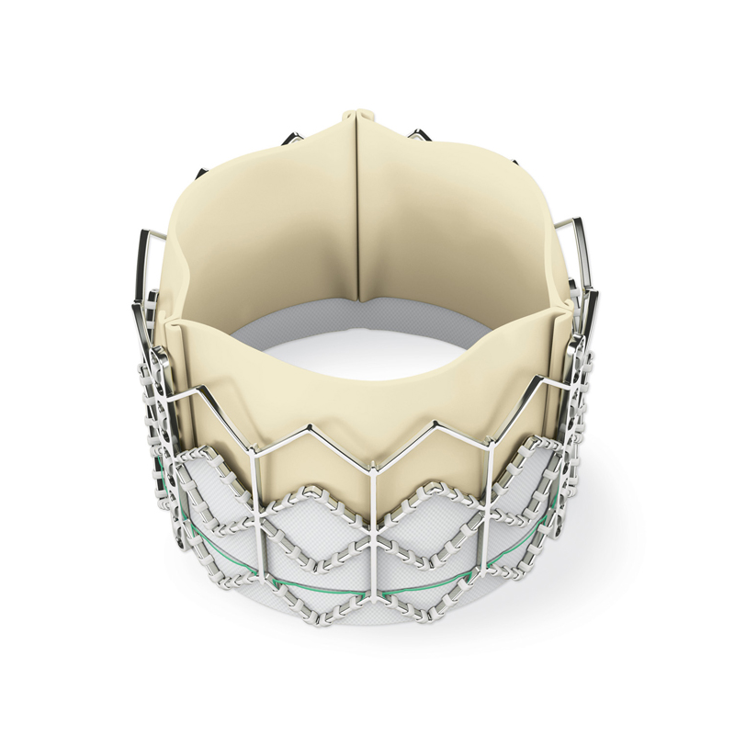
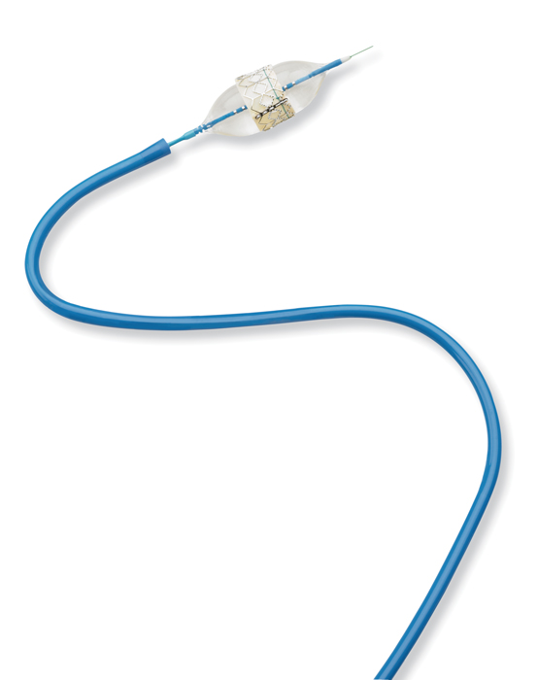
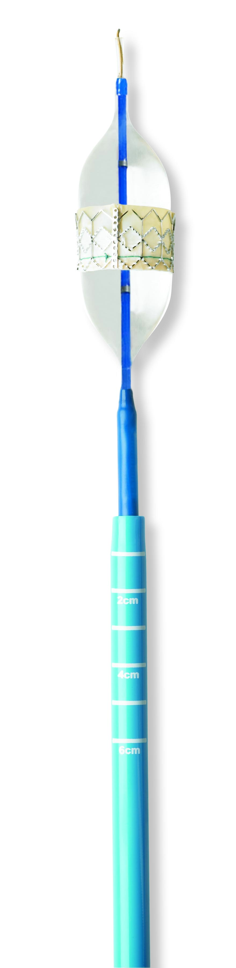
Study Devices
Transfemoral
Transapical
Edwards SAPIEN THV
23 and 26 mm valves
RetroFlex
22 and 24 F sheaths
Ascendra
24 and 26 F sheaths

Slide 10


Enrolling Study Sites
St. Paul's Hospital
Vancouver, Canada
Univ. of Washington
Seattle, WA
Hospital Laval
Quebec City, Canada
Mayo Clinic
Rochester, MN
Stanford University
Palo Alto, CA
Intermountain
Medical Center
Salt Lake City, UT
Brigham & Women’s
Mass General
Boston, MA
Evanston Hospital
Univ. of Penn
Phila., PA
Northwestern Univ.
Chicago, IL
Columbia University
Cornell University
New York, NY
Barnes-Jewish Hospital
St. Louis, MO
Cleveland Clinic
Cleveland, OH
Cedars-Sinai
Medical Center
Los Angeles, CA
St. Luke’s Hospital
Kansas City, MO
Washington
Hosp. Center
Wash., DC
Univ. of Virginia
Charlottesville, VA
Scripps Clinic
La Jolla, CA
Emory University
Atlanta, GA
Medical
City Dallas
Dallas, TX
Leipzig Heart Center
Leipzig, Germany
n = 699 patients
25 investigator sites
22 USA, 2 Canada, 1 Germany
Ochsner Foundation
New Orleans, LA
Univ. of Miami
Miami, FL

Slide 11
Key End-Points
All-cause mortality (primary endpoint)
Cardiovascular mortality
Rehospitalization
Strokes
Vascular and bleeding events
NYHA functional class
Echocardiographic measures of valve performance (including valve gradients/areas
and post-procedural aortic regurgitation)

Slide 12
Study Methodology
All patients followed for at least three years
Primary analysis performed by intention-to-treat (ITT), although as-treated (AT) analyses performed when appropriate (e.g. echo data = AT)
Event rates as Kaplan-Meier estimates, with groups compared by log-rank over the length of follow-up
Composite analyses pre-specified
Effect of baseline variables on 3-yr mortality studied with Cox proportional hazards regression (multivariable analysis with covariates p-value < 0.20)
Effect of procedural complications on 3-yr mortality studied with time-dependent covariate analysis

Slide 13
Study Flow
Randomized = 699 patients
Transfemoral
n = 492
TF = 492 (70%)
TA = 207 (30%)
Transapical
n = 207
TAVR (244)
AVR (248)
TAVR (104)
AVR (103)
3 Years
Alive = 132
Dead = 96
LTFU = 3
Withdrawal = 3
Ongoing F/U = 10
3 Years
Alive = 119
Dead = 101
LTFU = 3
Withdrawal = 17
Ongoing F/U = 8
3 Years
Alive = 45
Dead = 52
LTFU = 1
Withdrawal = 0
Ongoing F/U = 6
3 Years
Alive = 47
Dead = 42
LTFU = 1
Withdrawal = 10
Ongoing F/U = 3
91.0% follow-up at 3 years
91.5% follow-up at 3 years
86.5% follow-up at 3 years
92.2% follow-up at 3 years

Slide 14
Baseline Patient Characteristics
Demographics
Characteristic | TAVR (n=348) |  | AVR (n=351)
 | n |  | n
Age – years (Mean ± SD) | 348 | 83.6 ± 6.8 | 349 | 84.5 ± 6.4
Male | 201 | 57.8% | 198 | 56.7%
NYHA Class III or IV | 328 | 94.3% | 328 | 94.0%
Previous CABG | 148 | 42.5 | 152 | 43.6
Cerebrovascular disease | 96 | 29.4 | 87 | 26.8
Peripheral vascular disease | 149 | 43.2 | 142 | 41.6
STS Score (Mean ± SD) | 347 | 11.8 ± 3.3 | 349 | 11.7 ± 3.5

Slide 15
Baseline Patient Characteristics
Other Co-morbidities
Characteristic | TAVR (n=348) |  | AVR (n=351)
 | n | % | n | %
COPD – Any | 152 | 43.7 | 151 | 43.0
COPD – O₂ dependent | 38 | 17.3 | 38 | 16.6
Creatinine >2mg/dL | 37 | 10.8 | 22 | 6.4
Atrial fibrillation | 81 | 40.7 | 75 | 43.6
Pacemaker implant | 69 | 19.8 | 76 | 21.8
Pulmonary hypertension | 126 | 42.7 | 111 | 36.8

Slide 16
All-Cause Mortality (ITT)
  HR [95% CI] =
  0.93 [0.74, 1.15]
  p (log rank) = 0.483
44.8%
34.6%
44.2%
26.8%
33.7%
24.3%
No. at Risk
TAVR | 348 | 298 | 261 | 239 | 222 | 187 | 149
AVR | 351 | 252 | 236 | 223 | 202 | 174 | 142

Slide 17
All-Cause Mortality (ITT)
Landmark Analysis
TAVR
Mortality starting at 1 yr
AVR
  HR [95% CI] =
  1.02 [0.74, 1.40]
  p (log rank) = 0.922
All-Cause Mortality
26.8%
26.3%
24.3%
12.4%
24.5%
10.7%
Months
Numbers at Risk
TAVR | 348 | 298 | 261 | 239 | 222 | 187 | 149
AVR | 351 | 252 | 236 | 223 | 202 | 174 | 142
Notes:
For the left hand panel these are for the length of the trial. For the right hand panel these are for the length of the trial, but considering only the patients alive at 1 year.

Slide 18
Multivariable Baseline Predictors of Mortality (ITT) – TAVR
TAVR | Hazard Ratio [95% CI] | p-value
Body Mass Index (lbs/in²) | 0.95 [0.92, 0.98] | 0.0003
Atrial Fibrillation | 1.62 [1.15, 2.27] | 0.0056
Mean Gradient (Baseline) | 0.98 [0.97, 0.99] | 0.0033
Liver Disease | 2.39 [1.11, 5.14] | 0.0254
Renal Disease (CR ≥ 2) | 1.61 [1.11, 2.35] | 0.0131

Slide 19
Multivariate Baseline Predictors of Mortality (ITT) – AVR
AVR | Hazard Ratio [95% CI] | p-value
CABG | 0.67 [0.49, 0.92] | 0.0139
Pacemaker | 1.46 [1.03, 2.08] | 0.0353
Moderate or Severe MR (Baseline) | 1.52 [1.03, 2.23] | 0.0330
Liver Disease | 2.34 [1.09, 5.04] | 0.0302
STS Risk Score | 1.07 [1.02, 1.12] | 0.0048

Slide 20
Multivariate Baseline Predictors of Mortality (ITT) – Pooled
Pooled | Hazard Ratio [95% CI] | p-value
Body Mass Index (lbs/in²) | 0.96 [0.94, 0.98] | 0.0002
Atrial Fibrillation | 1.41 [1.11, 1.80] | 0.0050
Mean Gradient (Baseline) | 0.99 [0.98, 1.00] | 0.0095
Liver Disease | 2.38 [1.39, 4.09] | 0.0016
STS Risk Score | 1.04 [1.01, 1.07] | 0.0194

Slide 21
NYHA Class Survivors (ITT)
p = NS
p = 0.001
p = NS
p = NS
p = NS
15%
17%
19%
14%
24%
13%
15%
35%
94%
94%
IV
Percent of Patients
III
II
I
No. at Risk
348
349
307
266
250
226
205
186
151
133
Baseline
30 Days
1 Year
2 Years
3 Years

Slide 22

Strokes (ITT)
  HR [95% CI] =
  1.09 [0.62, 1.91]
  p (log rank) = 0.763
6.0%
7.7%
9.3%
3.2%
4.9%
8.2%
Months Post Randomization
No. at Risk
348 | 287 | 250 | 228 | 211 | 176 | 139
351 | 246 | 230 | 217 | 197 | 169 | 139
TAVR
AVR

Slide 23
Strokes (AT)
Notes:
23

Slide 24
All-Cause Mortality or Strokes (ITT)
  HR [95% CI] =
  0.98 [0.79, 1.21]
  p (log rank) = 0.839
47.1%
36.9%
45.9%
28.6%
36.1%
27.4%
No. at Risk
348 | 287 | 250 | 228 | 211 | 176 | 139
351 | 246 | 230 | 217 | 197 | 169 | 139
TAVR
AVR

Slide 25
Clinical Outcomes at 1, 2, and 3 Years (ITT)
All Patients (N=699)
 | 1 Year |  |  | 2 Years |  |  | 3 Years
Outcome | AVR (N = 351) | TAVR (N = 348) | p-value | AVR (N = 351) | TAVR (N = 348) | p-value | AVR (N = 351) | TAVR (N = 348) | p-value
Major Vasc. Comp. – no. (%) | 13 (3.8) | 42 (12.1) | <0.001 | 13 (3.8) | 43 (12.5) | <0.001 | 13 (3.8) | 43 (12.5) | <0.001
Major Bleeding – no. (%) | 88 (26.7) | 52 (15.7) | <0.001 | 95 (29.5) | 61 (19.3) | 0.003 | 99 (31.5) | 64 (20.8) | 0.003
New PM – no. (%) | 16 (5.0) | 21 (6.4) | 0.44 | 19 (6.3) | 24 (7.6) | 0.54 | 20 (6.8) | 25 (8.1) | 0.56
Endocarditis – no. (%) | 3 (1.0) | 2 (0.6) | 0.63 | 3 (1.0) | 4 (1.5) | 0.62 | 6 (2.6) | 4 (1.5) | 0.37
SVD§ Requiring AVR | 0 | 0 |  | 0 | 0 |  | 0 | 0
MI – no. (%) | 2 (0.6) | 0 | 0.16 | 4 (1.5) | 0 | 0.05 | 6 (2.7) | 2 (1.1) | 0.23
Acute Kidney Inj.* – no. (%) | 20 (6.5) | 18 (5.4) | 0.57 | 22 (7.3) | 20 (6.2) | 0.59 | 23 (7.9) | 22 (7.2) | 0.76
§ SVD = Structural Valve Deterioration
* Renal replacement therapy
Notes:
25

Slide 26
Echocardiographic Findings (AT)
Aortic Valve Area
p = NS
p = 0.0005
p = 0.0017
p = 0.0019
p = NS
p = NS
p = NS
No. of Echos
304 | 271 | 223 | 211 | 150 | 88
294 | 226 | 163 | 154 | 121 | 70
TAVR
AVR

Slide 27
Echocardiographic Findings (AT)
Mean & Peak Gradients
No. of Echos
310 | 277 | 233 | 219 | 155 | 88
299 | 230 | 169 | 158 | 123 | 72
TAVR
AVR

Slide 28
Paravalvular Aortic Regurgitation (AT)
p < 0.0001
p < 0.0001
p < 0.0001
p < 0.0001
p < 0.0001
No. of Echos
279 | 228 | 230 | 173 | 217 | 158 | 156 | 122 | 88 | 72

Slide 29
Impact of Total AR on Mortality (AT)
TAVR Patients
60.8%
53.7%
44.6%
38.2%
32.5%
26.0%
35.3%
25.6%
12.3%
No. at Risk
None-Tr
131 | 121 | 114 | 102 | 93 | 80 | 63
171 | 146 | 125 | 117 | 110 | 94 | 62
34 | 24 | 21 | 18 | 15 | 12 | 9
Mild
Mod-Sev

Slide 30
Impact of Mild PVL on Mortality (AT)
TAVR Patients
51.0%
45.8%
50.4%
33.3%
37.7%
33.9%
28.9%
24.3%
14.4%
No. at Risk
None-Tr
168 | 150 | 142 | 130 | 120 | 106 | 81
139 | 119 | 98 | 91 | 83 | 67 | 42
24 | 18 | 16 | 14 | 13 | 11 | 9
Mild
Mod-Sev

Slide 31
Mortality in Patients with None-Trace AR (AT)
TAVR vs AVR
  HR [95% CI] =
  0.81 [0.58, 1.12]
  p (log rank) = 0.202
41.5%
29.3%
35.3%
23.7%
25.6%
12.3%
No. at Risk
TAVR | 131 | 121 | 114 | 102 | 93 | 80 | 63
AVR | 256 | 205 | 192 | 184 | 165 | 147 | 109

Slide 32
Impact of STS Score on Mortality (ITT)
AVR Patients
47.6%
37.3%
30.5%
42.0%
32.0%
23.1%
No. at Risk
176 | 133 | 122 | 116 | 106 | 94 | 79
175 | 119 | 114 | 107 | 96 | 80 | 63
STS ≤11
STS >11

Slide 33
Impact of STS Score on Mortality (ITT)
TAVR Patients
49.1%
36.1%
28.8%
39.6%
31.4%
19.9%
No. at Risk
177 | 155 | 141 | 128 | 117 | 106 | 87
171 | 143 | 120 | 111 | 105 | 81 | 62
STS ≤11
STS >11

Slide 34
Conclusions (1)
At 3 years, in patients with symptomatic severe AS who were high-risk candidates for surgical AVR …
  There was no difference in all-cause mortality between TAVR and surgery
  Baseline predictors of mortality were different for TAVR (e.g. BMI, PVD) and surgery (e.g. STS score, mod/severe MR)
  Symptom improvement was similar in both groups and maintained thru three years
At 3 years, strokes were similar in TAVR and surgery patients, despite increased peri-procedural neurologic events in TAVR patients
  There was no late (after 30 days) stroke hazard in TAVR compared with surgery
Notes:
34

Slide 35
Conclusions (2)
Echocardiographic analysis revealed…
  At 3 years, TAVR hemodynamic performance was maintained with similar valve gradients and areas compared with surgery
  Both AVR and surgery resulted in significant LVEF improvement and LV mass regression
  Post-procedural paravalvular AR was frequent after TAVR (mild-mod-severe ~ 50% pts) without important changes
  during 3 year FU
  Even mild post-procedural AR (PVL and total AR) was associated with increased subsequent mortality
Notes:
35

Slide 36
Implications
3-year results from the high-risk operable PARTNER cohort indicate…
  TAVR should be considered an alternative to surgery with
  similar mortality and similar other major clinical outcomes
  Peri-procedural stroke concerns after TAVR have diminished with longer term follow-up
  TAVR valve hemodynamics have remained stable, although peri-procedural regurgitation (even mild) has emerged as a predictor of late mortality
Future efforts should be directed towards reducing
TAVR procedure-related complications, including strokes, vascular events, and paravalvular regurgitation
Notes:
36

Slide 37
Thank you
PARTNER TEAM

